Slide 1
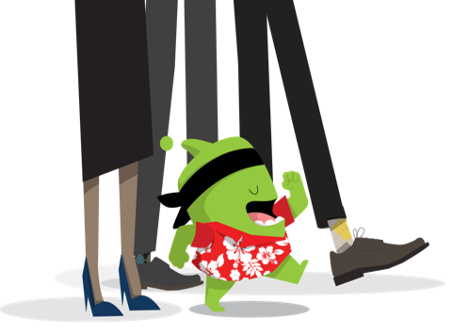
Parent Information Night
2019-2020
Welcome to room 3!

Slide 2
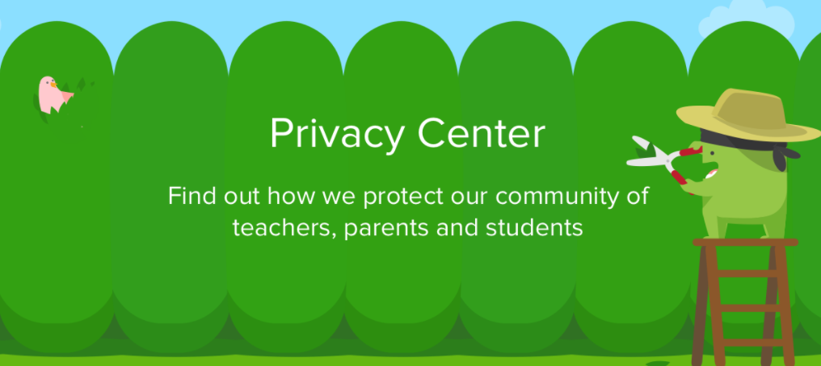
Due to privacy issues and time constraints, please save questions and concerns about your child’s academic or behavioral performance for a private phone call or conversation.

Slide 3




A little about myself...
I received my bachelor’s degree from Bridgewater State College, my master’s degree at Central CT State University in educational technology and a second master’s degree in Curriculum, Instruction and Assessment through Walden University. This will be my 23rd year working for the W.L. Public Schools and my 11th non-consecutive year teaching third grade at South Elementary School. I have also taught 4th , 5th, and 6th grade in the past.

Slide 4
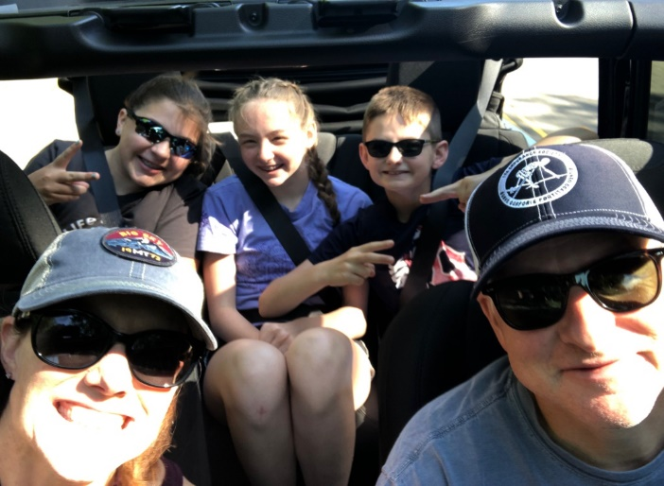
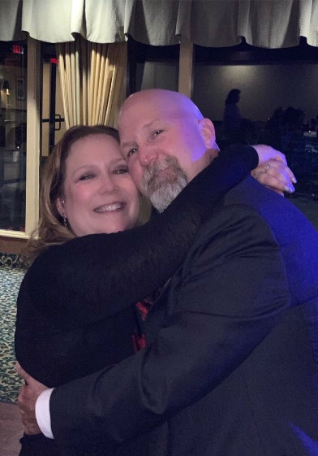
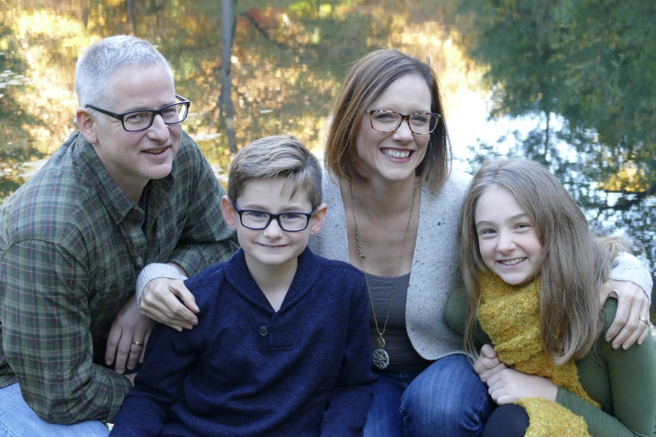
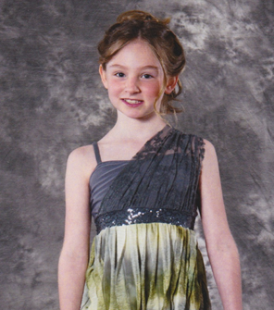
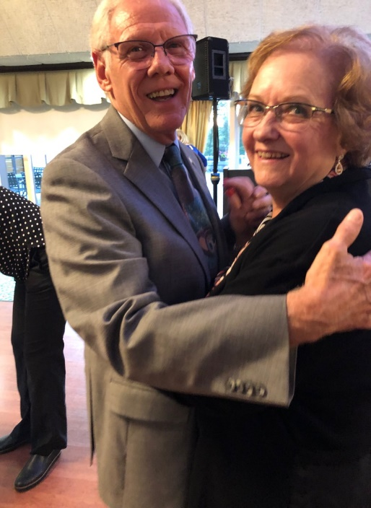
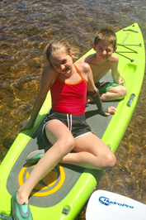
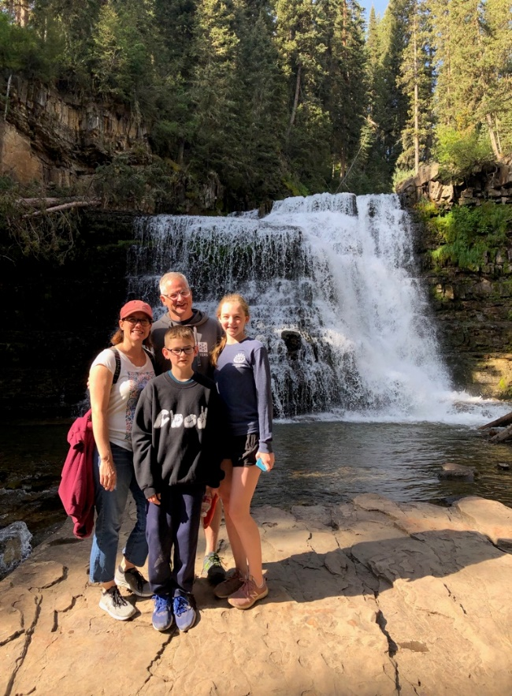
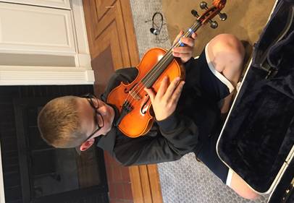

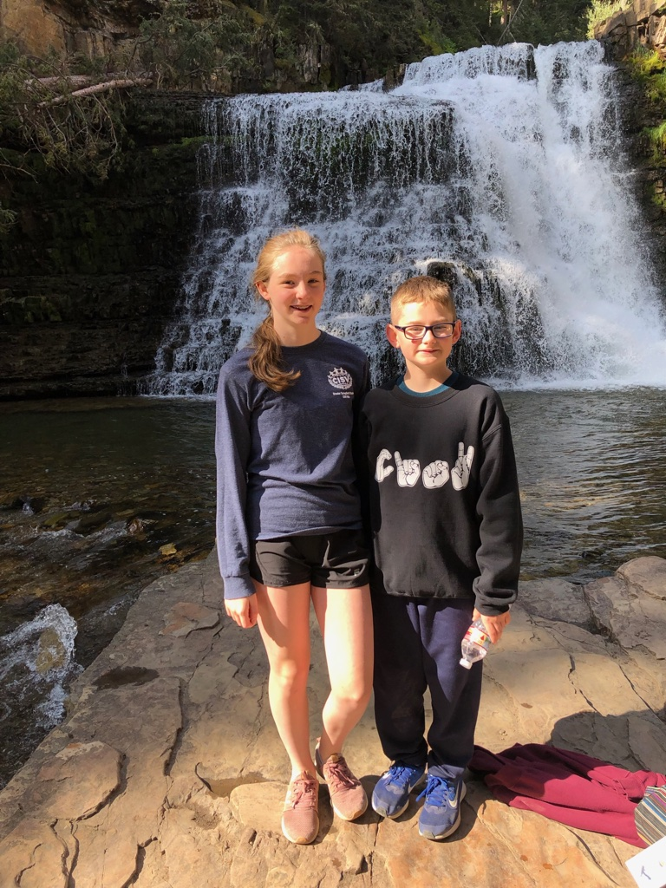
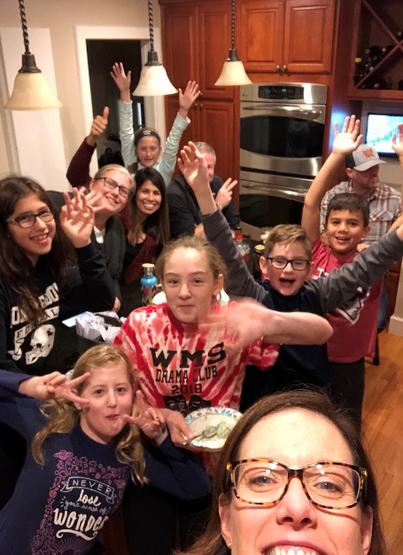
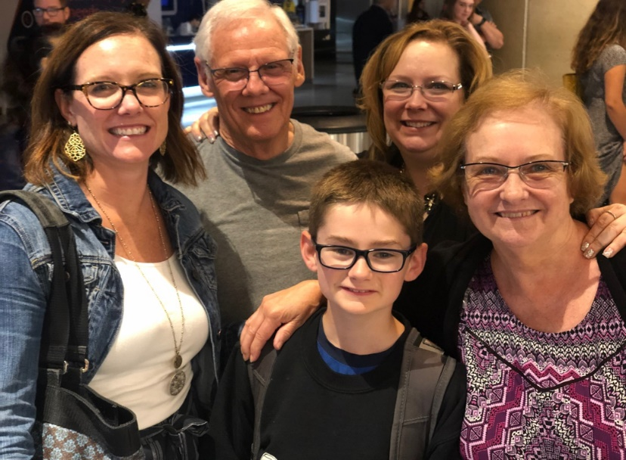
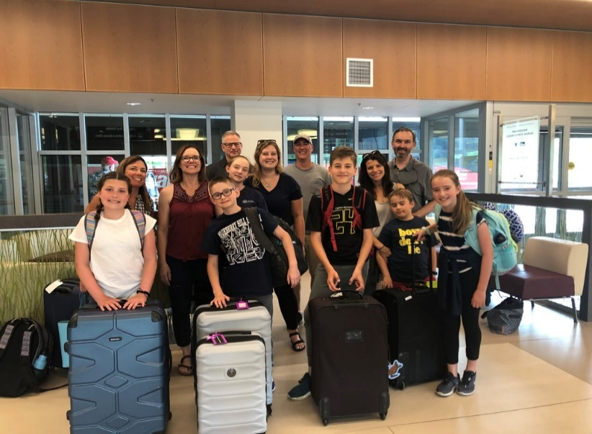
My family & activities we like

Slide 5
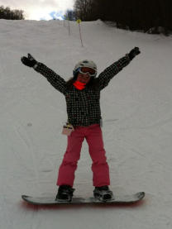
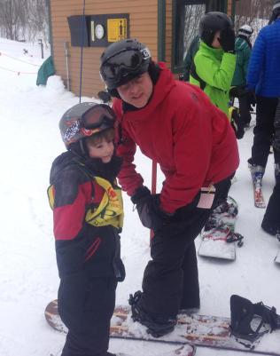
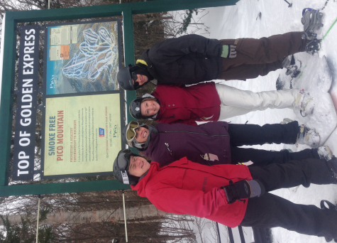
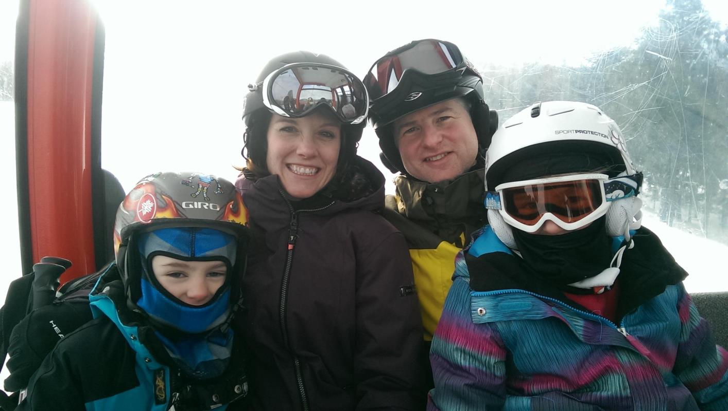
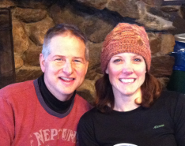
Skiing & Snow boarding

Slide 6



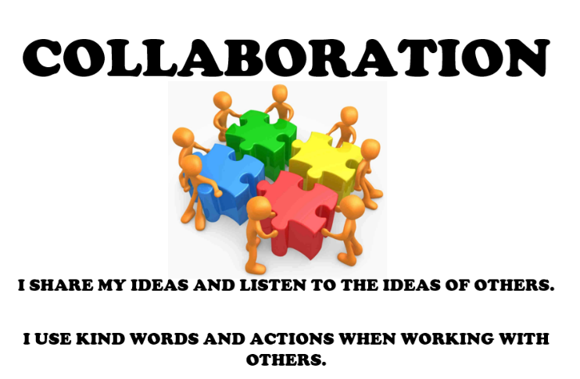
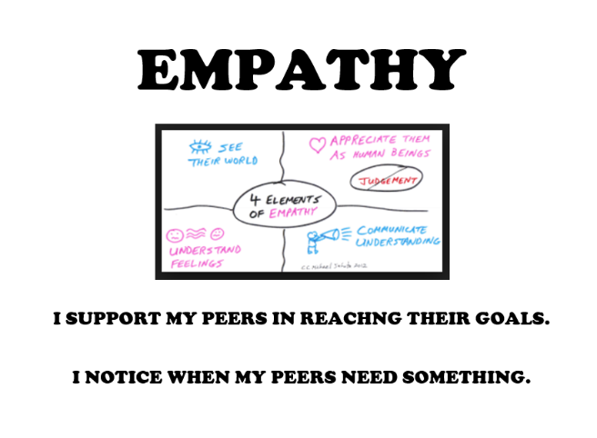
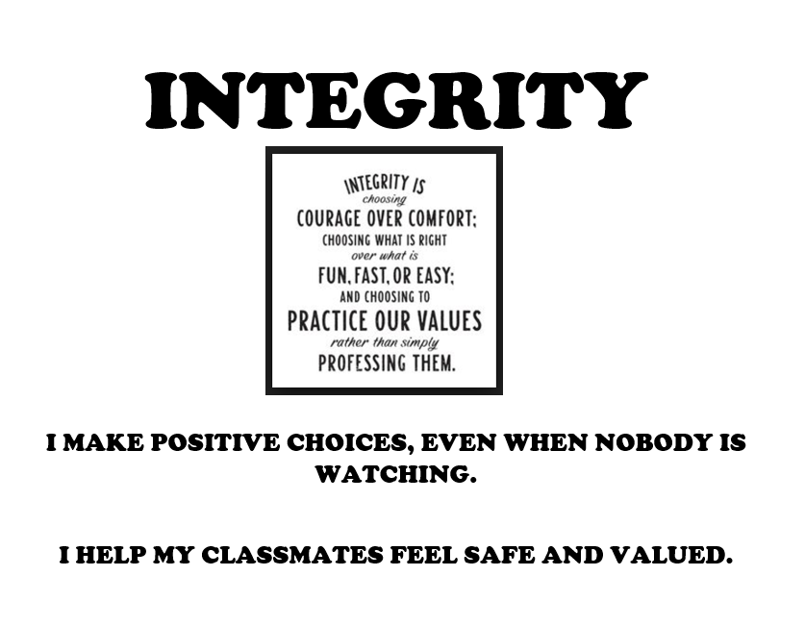
SES Code of Character
One way that we teach these traits is through our CREW meetings.

Slide 7
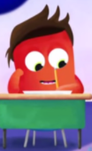
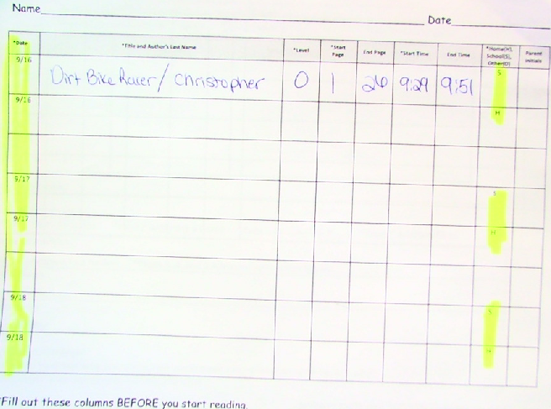
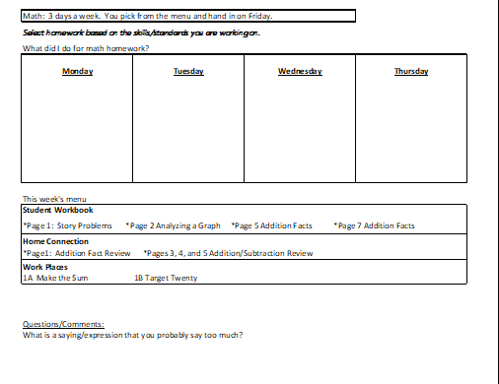
Homework
Homework is organized on the weekly "Homework Plan." Students are expected to have it every day to write the math homework that they chose for the week and their home reading and school reading on the reading log.
Reading Log
Math HW
**Please remember to sign your child's HW Plan, and log every night this month. After that, I will only check those students who struggle with organizing their planners and homework.

Slide 8




Portfolios/Student-Led Conferences
Students collect and reflect upon work looking for growth. This allows ​students to take ownership of learning. With this knowledge the ​students will help set goals, develop and evaluate plans as they work ​towards showing mastery of Third Grade Standards.
Students need to know:
√ expectations for the Unit, Trimester, End of Third Grade;
√strengths;
√areas they are working to develop;
√strategies that work/do not work;
next steps
√

Slide 9

A few more things...
Snack - any time!
Healthy Choices (Fruit, veggies, crackers and cheese, granola bars, dry cereal...)
Treats for any occasion - peanut free
Contact me ahead of time
Manageable in the classroom
Please avoid treats that come with toys
Field Trip Chaperones
Background Check
Cell Phones
must be turned off and in backpack & no pictures can be taken

Slide 10
Family Engagement...
Home Visits
Class DoJo
Learning Partnerships

Slide 11


Communication
Communication with you is very important!
Please feel free to contact me as necessary.
The best way to reach me is through Class DoJo
lweppler@wlps.org or phone/voice mail (860)292-3953.
I will respond as soon as possible.

Slide 12
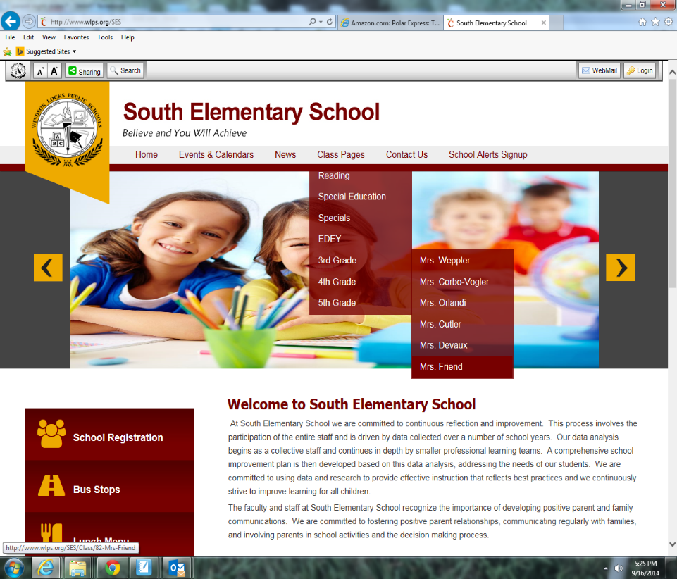
School/Class Website
Visit Our site to see the rest of this slide show!
www.wlps.org/ses
click: class pages/3rd grade/ Mrs. Weppler

Slide 13
Typical Classroom Routine
7:55-8:10 Morning routine
8:10-8:30 CREW: greeting, initiative, debrief
8:30 - 8:50 NUMBER CORNER
8:50 - Bathroom Break
8:50-10:00 READING
10:00-10:50 - WRITING
10:50-11:10 LUNCH - Bathroom Break
11:10-11:30 - RECESS
11:35-12:10 - iBLOCK
12:10-12:20 - Quiet Time - Bathroom Break
12:20-1:10- MATH
1:10-1:20 - PLANNER TIME
1:20-2:00 - SCIENCE or SOCIAL STUDIES
2:00-2:45 - SPECIAL - Bathroom Break
2:55 - DISMISSAL

Slide 14


Every child wants to:
Belong , Feel Significant, and Have Fun!
CREW
Strengthens community and provides a positive environment ​for taking risks and learning.

Slide 15



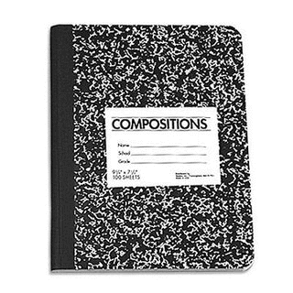
Reading
Reading workshop daily schedule
Mini-lesson
Independent Reading or Writing
Mid-Workshop Interruptions
Partner time
Whole class share
Teacher Conferences/Small Group Work

Slide 16

Reading Just Right Books
How do I know if a book is my level?
I can read most of the words. (5 Finger Rule)
I can understand the story.
I am enjoying the book.
My reading rate is just right.
I can figure out the tricky words and still understand the story.
I can read smoothly.

Slide 17

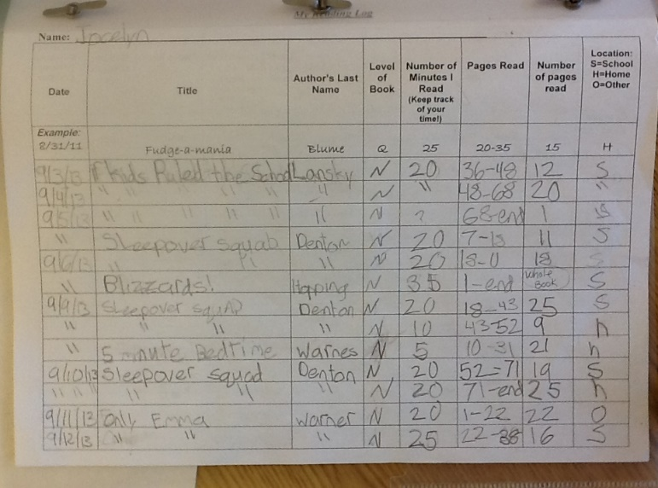
Reading Logs
Purpose
Tracking volume, stamina, and completion
Goal setting, planning next steps
Accountability for reading growth
Expectations
Reading same book in school and home to completion
Log is completely filled out
Reading a just-right book at school and choice at home
Legible
Back-up plan

Slide 18


Writing
Narrative
Informational
Opinion
Gathering
Developing/Planning
Drafting
Revising
Editing
Publishing
Assessment
Overall, Lead, Transitions, Ending, Organization, Elaboration, Craft, Punctuation, Spelling

Slide 19
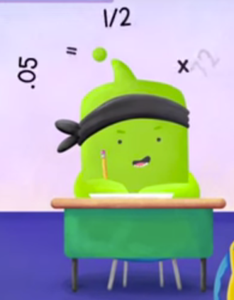

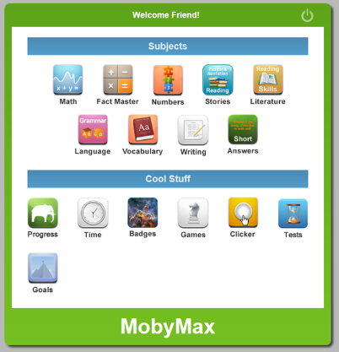
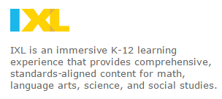
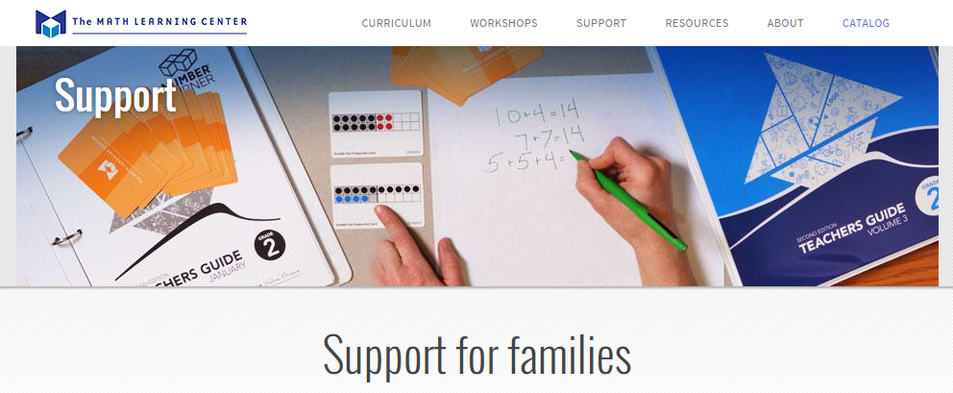
Math Bridges
Number Corner
1. Addition and Subtraction Patterns
2. Introduction to Multiplication
3. Multi-digit Addition and Subtraction
4. Measurement and Fractions
5. Multiplication, Division, and Area
6. Geometry
7. Extending Multiplication and Fractions
8. Bridge Design and Construction: Data Collection & Analysis

Slide 20

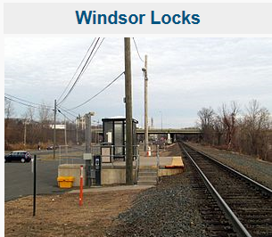




Social Studies

Slide 21


Science
Changing Environments
Forces and Motion
Populations
Living Things
*Students will rotate to different third grade teachers for each unit!

Slide 22

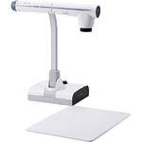
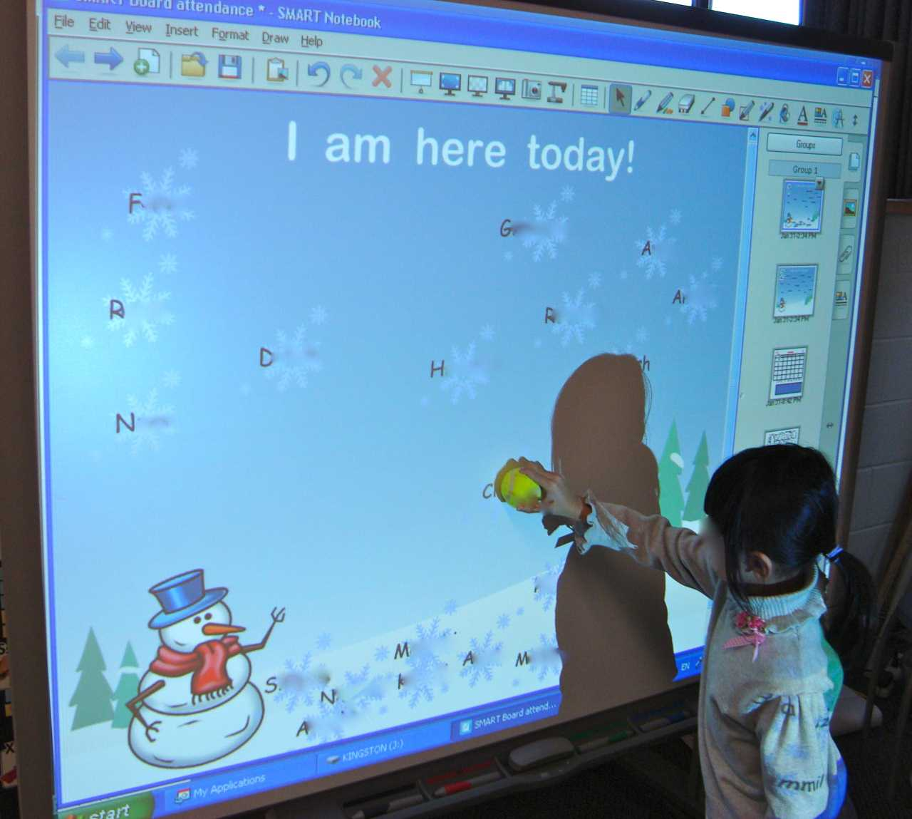
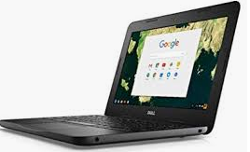



Technology in the Classroom
Students will be given multiple ​opportunities to use technology to ​enhance their educational ​experience.

Slide 23

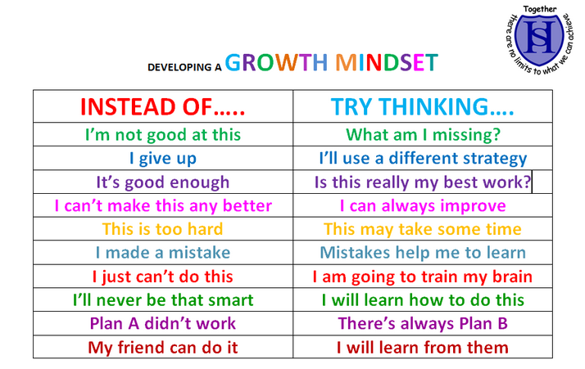
In our class, we have a GROWTH MINDSET!

Slide 24

Thank you for attending tonight!
Be sure to visit all of the adults that make a difference in your child's ​school life!
Mrs. Long - Art
Mr. Lepak - P.E.
Ms. Zajac - Library
Miss O'Connell - Speech & Language
Mrs. O'Donnell, Mrs. Wicks or Mrs. Belzek - Reading
Mrs. Smith - School Psychologist
Ms. Foy - Enrichment
Mrs. Salling - Instructional Specialist
Ms. Briggs - Principal

Slide 25

General Questions?
(Reminder: Due to privacy issues and time constraints, please save questions and concerns about your child’s academic or behavioral performance for a private phone call or conversation.)
Come and ask me or message me on DoJo!

